Slide 1
18CSC305J-Artificial Intelligence
Unit- V

Slide 2
Advance topics in Artificial Intelligence- Cloud Computing and Intelligent agent
Business Intelligence and Analytics
Sentiment Analysis
Deep Learning Algorithms
Planning and Logic in intelligent Agents
Expert System Architecture
Pros and cons of Expert system
Rule based systems
Frame based expert system
Case study
NLP – levels of NLP
Syntactic and Semantic Analysis
Information Retrieval
Information Extraction
Machine Translation
NLP Applications

Slide 3
Expert Systems

Slide 4
Expert Systems - Objectives
Learn the meaning of an expert system
Understand the problem domain and knowledge domain
Learn the advantages of an expert system
Understand the stages in the development of an expert system
Examine the general characteristics of an expert system

Slide 5
Objectives
Examine earlier expert systems which have given rise to today’s knowledge-based systems
Explore the applications of expert systems in use today
Examine the structure of a rule-based expert system
Learn the difference between procedural and nonprocedural paradigms
What are the characteristics of artificial neural systems

Slide 6
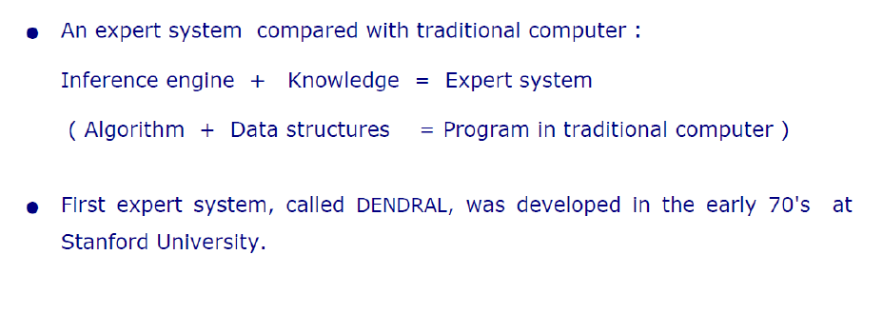
What is an expert system?
“An expert system is a computer system that emulates, or acts in all respects, with the decision-making capabilities of a human expert.”
Professor Edward Feigenbaum
Stanford University

Slide 7
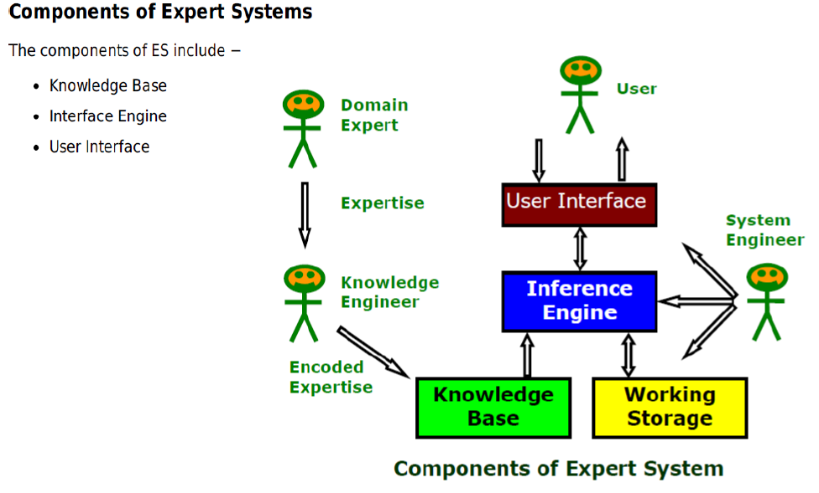
Architecture of Expert Systems

Slide 8
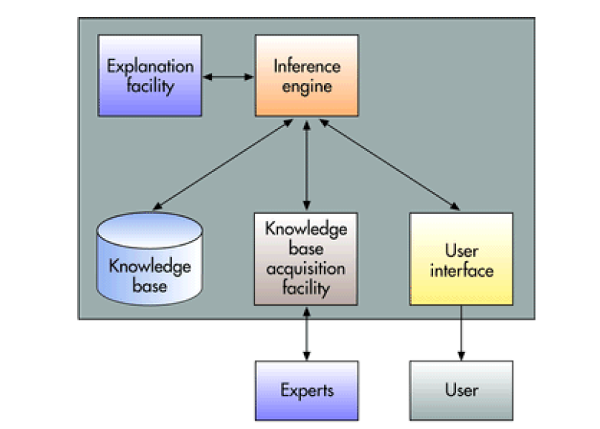
Architecture of Expert Systems
Knowledge Base
Stores all relevant information, data, rules, cases, and relationships used by the expert system.
Uses
•Rules
•If-then Statements
•Fuzzy Logic
Inference Engine
Seeks information and relationships from the knowledge base and provides answers, predictions, and suggestions the way a human expert would.
Uses
•Backward Chaining
•Forward Chaining

Slide 9
Architecture of Expert Systems
Explanation Facility
Allows a user to understand how the expert system arrived at certain conclusions or results.
For example: it allows a doctor to find out the logic or rationale of the diagnosis made by a medical expert system
Knowledge acquisition facility
Provide convenient and efficient means of capturing and storing all the components of the knowledge base.
Acts as an interface between experts and the knowledge base.
User Interface
Specialized user interface software employed for designing, creating, updating, and using expert systems.
The main purpose of the user interface is to make the development and use of an expert system easier for users and decision makers

Slide 10
General Methods of Inferencing
Forward chaining (data-driven)– reasoning from facts to the conclusions resulting from those facts – best for prognosis, monitoring, and control.
Examples: CLIPS, OPS5
Backward chaining (query/Goal driven)– reasoning in reverse from a hypothesis, a potential conclusion to be proved to the facts that support the hypothesis – best for diagnosis problems.
Examples: MYCIN

Slide 11
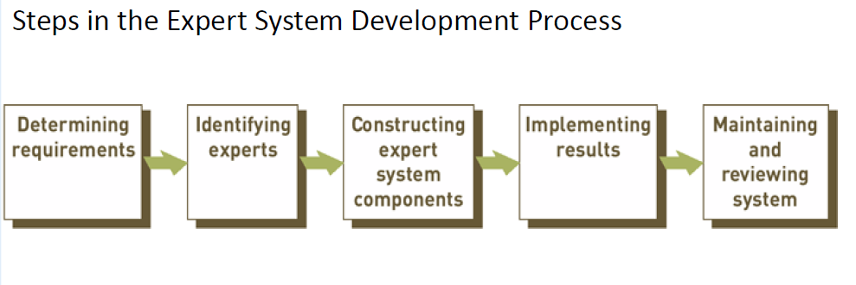
Expert Systems Development

Slide 12
Expert system technology may include:
Special expert system languages – CLIPS
Programs
Hardware designed to facilitate the implementation of those systems

Slide 13
Problem Domain vs. Knowledge Domain
An expert’s knowledge is specific to one problem domain – medicine, finance, science, engineering, etc.
The expert’s knowledge about solving specific problems is called the knowledge domain.
The problem domain is always a superset of the knowledge domain.

Slide 14
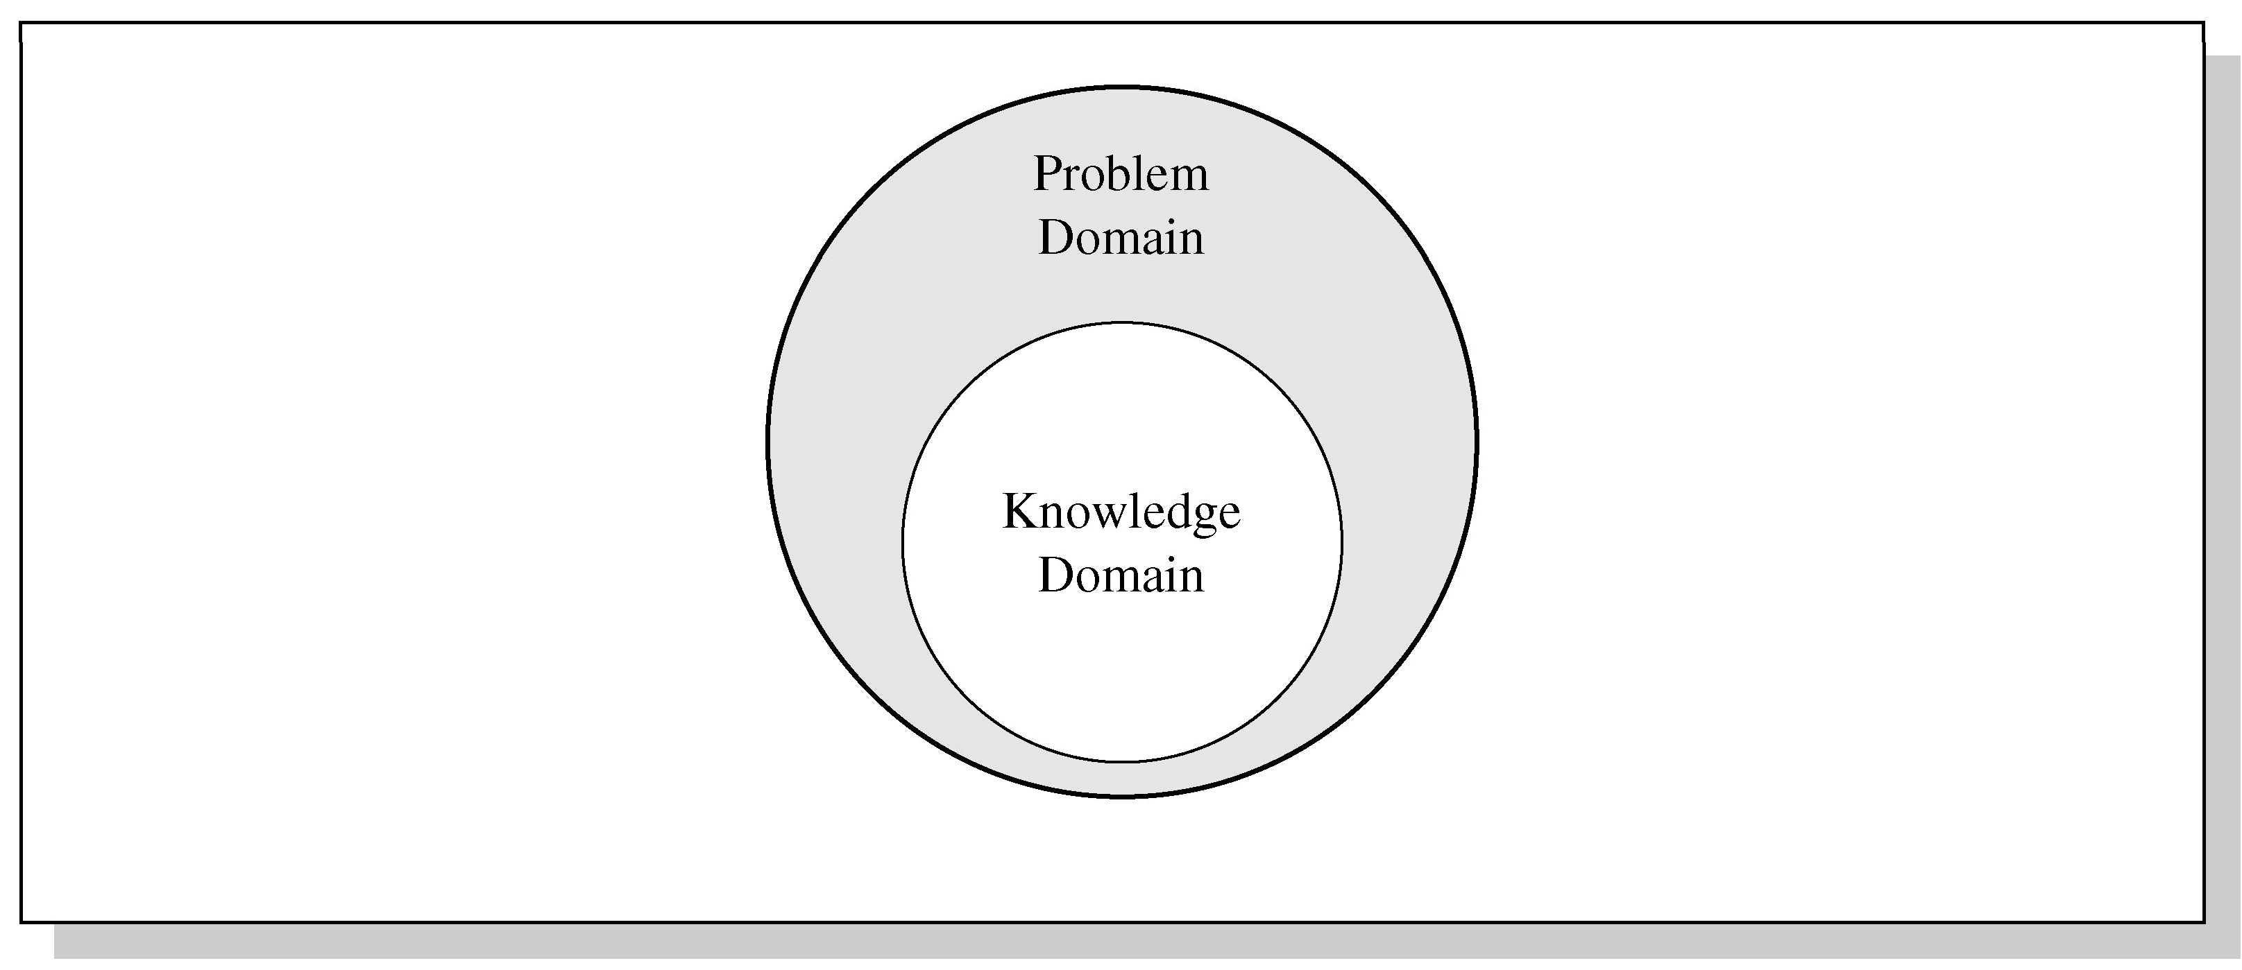
Problem and Knowledge Domain Relationship

Slide 15
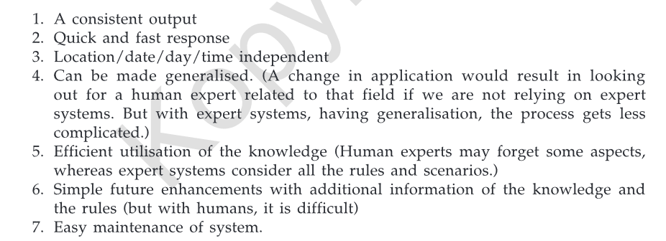
Advantages of Expert Systems

Slide 16
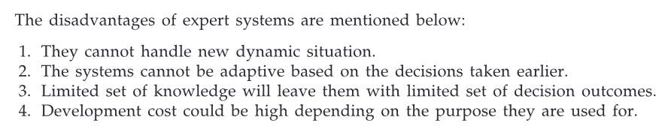
Disadvantages of Expert Systems

Slide 17
Representing the Knowledge
The knowledge of an expert system can be represented in a number of ways, including IF- THEN rules:
IF you are hungry THEN eat

Slide 18
Knowledge Engineering
The process of building an expert system:
The knowledge engineer establishes a dialog with the human expert to elicit knowledge.
The knowledge engineer codes the knowledge explicitly in the knowledge base.
The expert evaluates the expert system and gives a critique to the knowledge engineer.

Slide 19
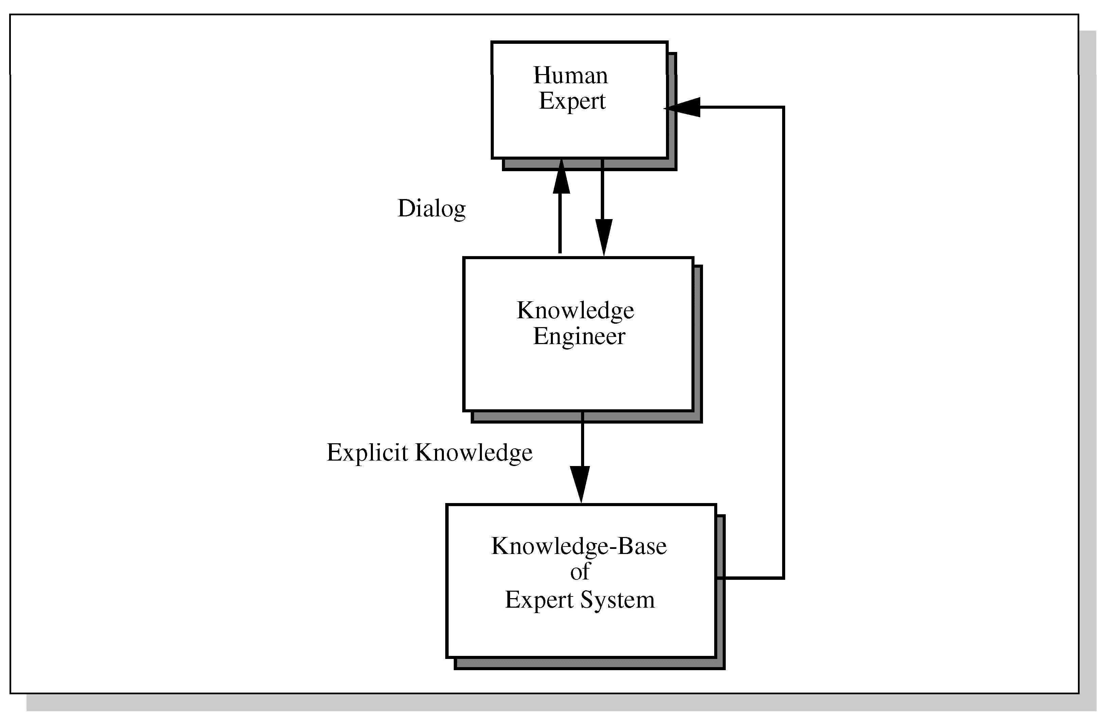
Development of an Expert System

Slide 20
The Role of AI
An algorithm is an ideal solution guaranteed to yield a solution in a finite amount of time.
When an algorithm is not available or is insufficient, we rely on artificial intelligence (AI).
Expert system relies on inference – we accept a “reasonable solution.”

Slide 21
Uncertainty
Both human experts and expert systems must be able to deal with uncertainty.
It is easier to program expert systems with shallow knowledge than with deep knowledge.
Shallow knowledge – based on empirical and heuristic knowledge.
Deep knowledge – based on basic structure, function, and behavior of objects.

Slide 22
Early Expert Systems
DENDRAL – used in chemical mass spectroscopy to identify chemical constituents
MYCIN – medical diagnosis of illness
DIPMETER – geological data analysis for oil
PROSPECTOR – geological data analysis for minerals
XCON/R1 – configuring computer systems

Slide 23
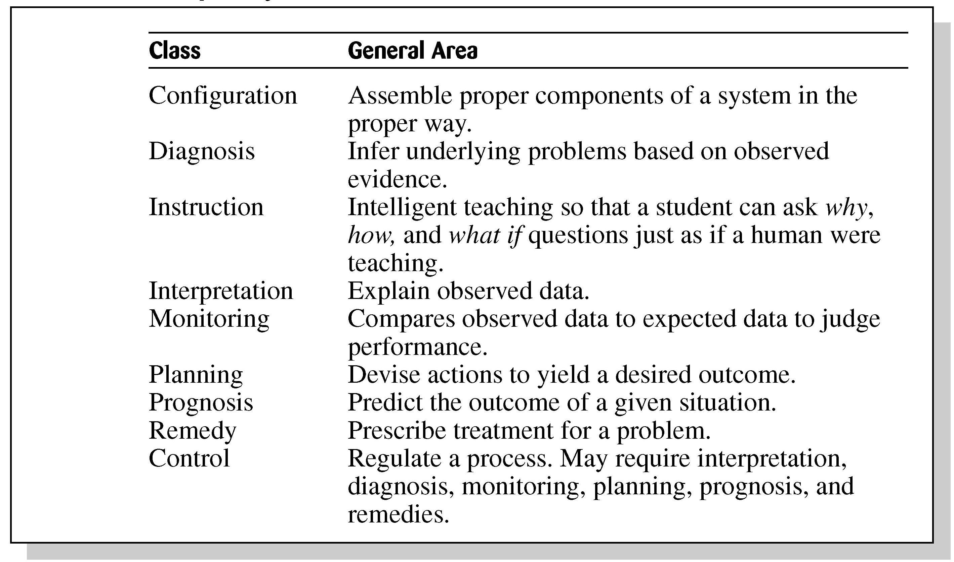
Broad Classes of Expert Systems

Slide 24
Problems with Algorithmic Solutions
Conventional computer programs generally solve problems having algorithmic solutions.
Algorithmic languages include C, Java, and C#.
Classical AI languages include LISP and PROLOG.

Slide 25
Considerations for Building Expert Systems
Can the problem be solved effectively by conventional programming?
Is there a need and a desire for an expert system?
Is there at least one human expert who is willing to cooperate?
Can the expert explain the knowledge to the knowledge engineer can understand it.
Is the problem-solving knowledge mainly heuristic and uncertain?

Slide 26
Languages, Shells, and Tools
Expert system languages are post-third generation.
Procedural languages (e.g., C) focus on techniques to represent data.
More modern languages (e.g., Java) focus on data abstraction.
Expert system languages (e.g. CLIPS) focus on ways to represent knowledge.

Slide 27
Production Rules
Knowledge base is also called production memory.
Production rules can be expressed in IF-THEN pseudocode format.
In rule-based systems, the inference engine determines which rule antecedents are satisfied by the facts.

Slide 28
Rule-Based Expert System
A rule based expert system is the simplest form of artificial intelligence and uses prescribed knowledge based rules to solve a problem
The aim of the expert system is to take knowledge from a human expert and convert this into a number of hardcoded rules to apply to the input data
In their most basic form, the rules are commonly conditional statements (if a, then do x, else if b, then do y)
These systems should be applied to smaller problems, as the more complex a system is, the more rules that are required to describe it, and thus increased difficulty to model for all possible outcomes
Example:
A very basic example of rule based expert system would be a program to direct the management of abdominal aneurysms The system would input the diameter of an aneurysm Using conditional arguments, the input diameter would be stratified to recommend whether immediate intervention was required, and if not what appropriate follow up is recommended
Note: with problems related to radiological images, often preprocessing of the images is required prior to the expert system being applied.

Slide 29
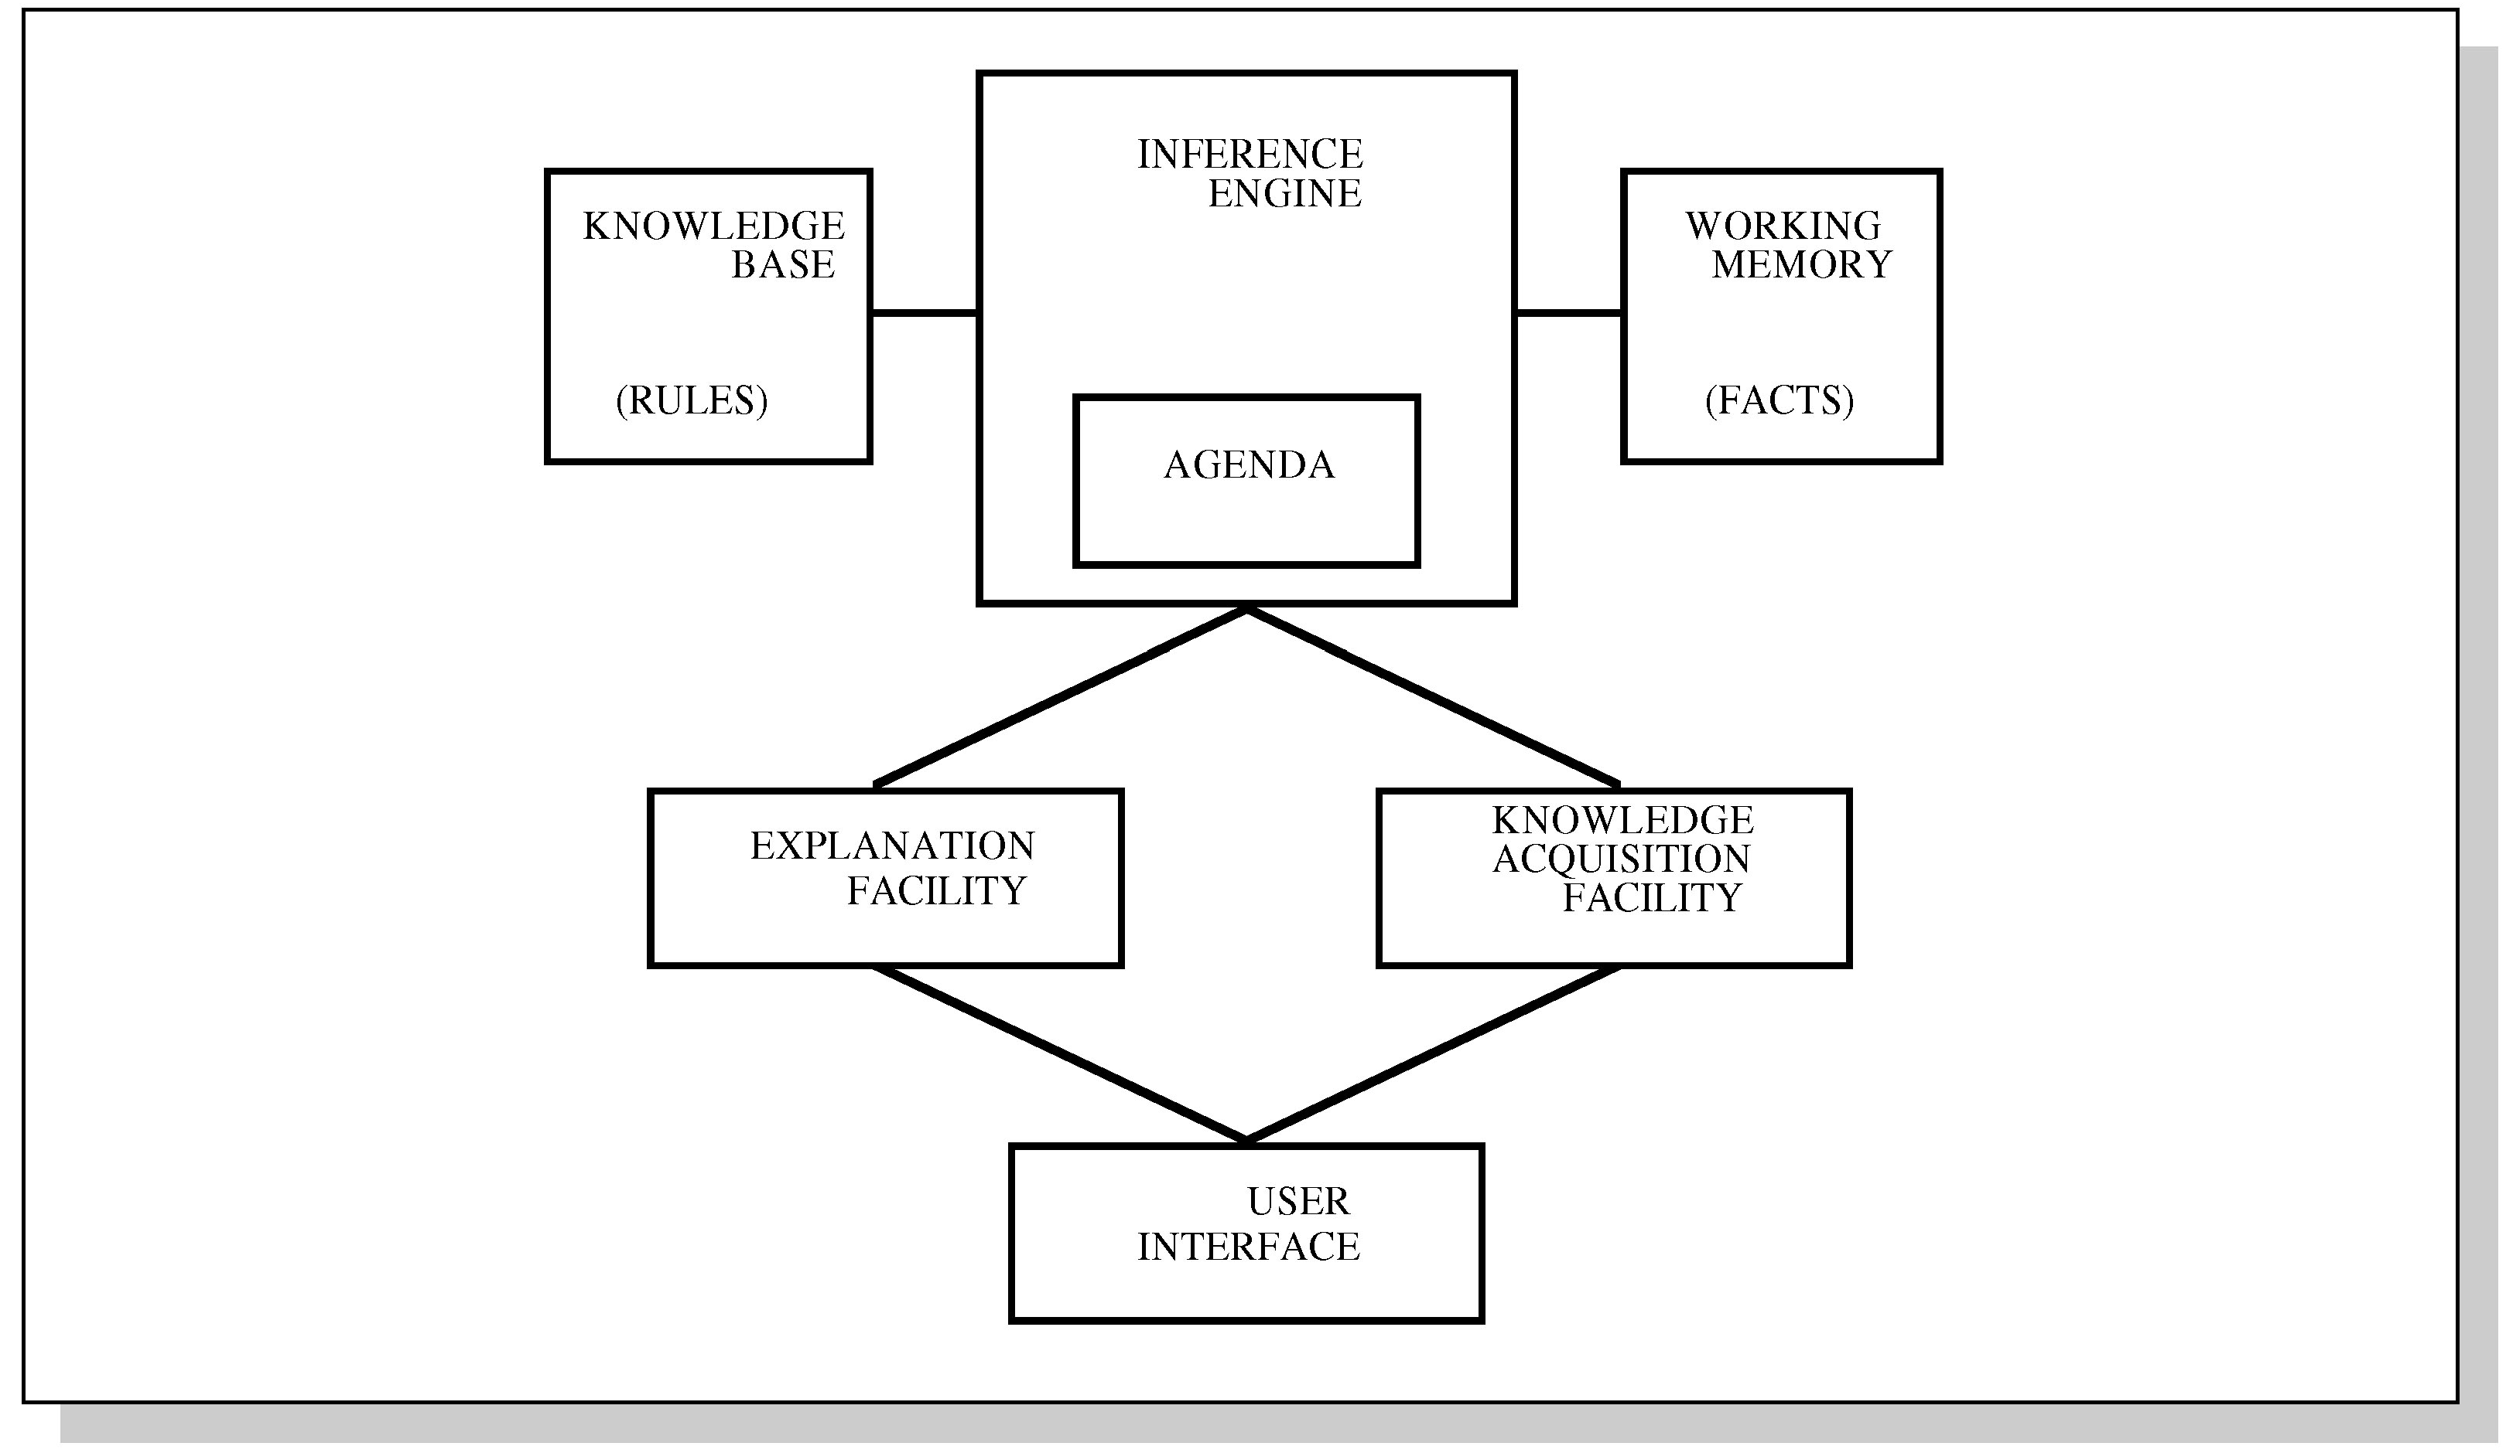
Structure of a Rule-Based Expert System

Slide 30
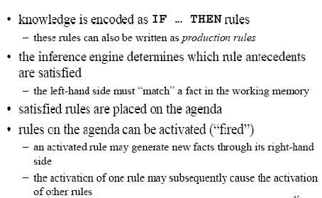
Rule-Based ES

Slide 31
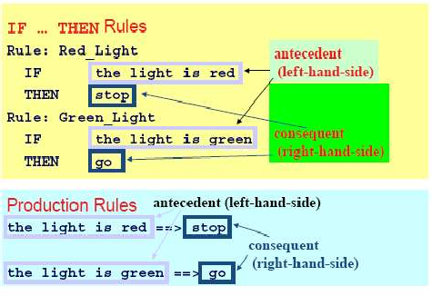
Example Rules

Slide 32
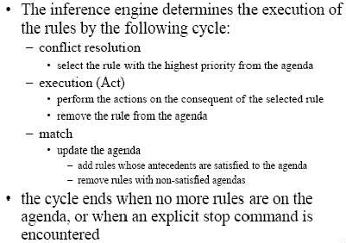
Inference Engine Cycle

Slide 33
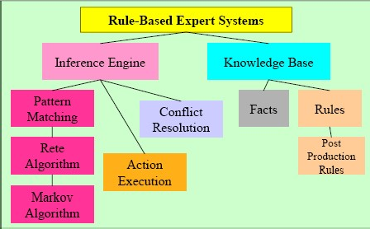
Foundation of Expert Systems

Slide 34
Markov Algorithm
An ordered group of productions applied in order or priority to an input string.
If the highest priority rule is not applicable, we apply the next, and so on.
inefficient algorithm for systems with many rules.
Termination on (1) last production not applicable to a string, or (2) production ending with period applied
Can be applied to substrings, beginning at left

Slide 35
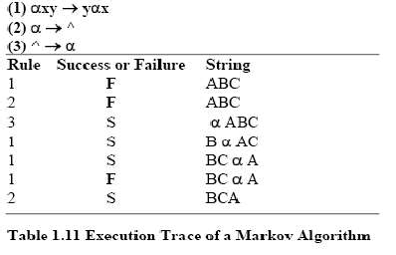
Markov Algorithm

Slide 36
Rete Algorithm
Markov: too inefficient to be used with many rules
Functions like a net – holding a lot of information.
Much faster response times and rule firings can occur compared to a large group of IF-THEN rules which would have to be checked one-by-one in conventional program.
Takes advantage of temporal redundancy and structural similarity.
Looks only for changes in matches (ignores static data)
Drawback is high memory space requirements.

Slide 37
Frame-Based Expert System
The expert systems which make use of frames for the knowledge are called frame-based expert systems.
What is a frame? – A frame is a data structure with typical knowledge about the object or concept.
Frame has its name and set of attributes
Example : A car frame can have make, type, color and so on as slots/attributes in the frame
Each slot/ attribute has unique value associated to it

Slide 38
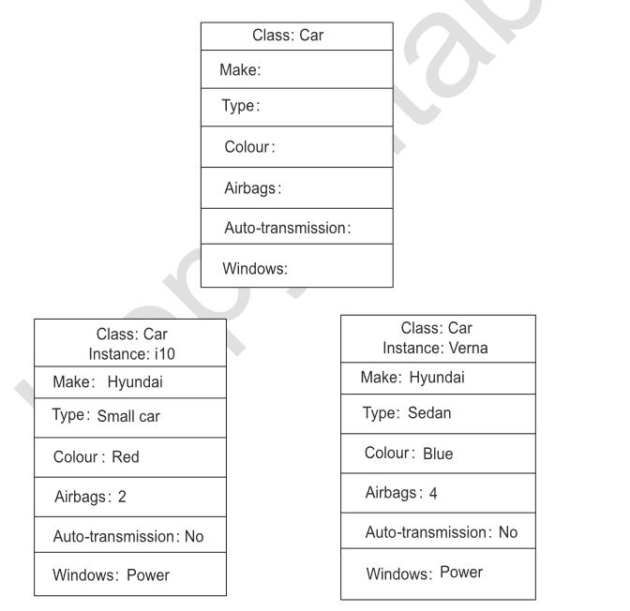
Frame-Based Expert System
We can have the following included in the slot
Frame Name
Relationship with other frames
Values or Ranges
Procedural information
Represents the frame structure for Class and Instance

Slide 39
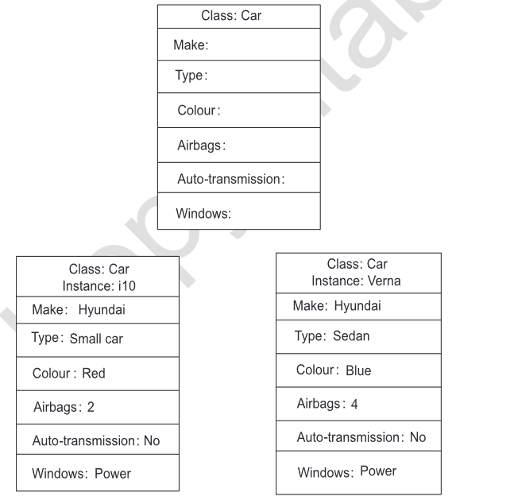
Frame-Based Expert System
Relationship – hierarchy, or to be specific, the inheritance is depicted
Values & Ranges – Represent the actual/default values or specified ranges
Procedural information – the slot is attached to a procedure that is executed when any event is triggered such as change in value for the slot
Instance Frame refers to an object and Class frame refers to group
Frames : Class and Instance

Slide 40
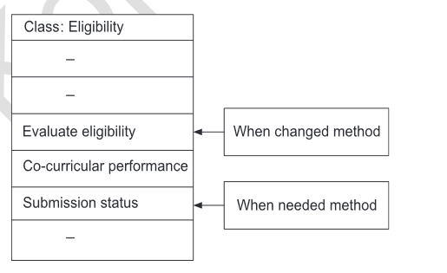
Working of Frame-Based Expert System
Method – A method is a procedure that is executed when requested
Demon – makes use of if-then structure
Frames that have the knowledge representation, the methods or the demons essentially add actions to them.
As an example, how the process of an expert system works to check the eligibility of a student appearing for an exam is explained in the picture
When needed and when required methods : Snapshot

Slide 41
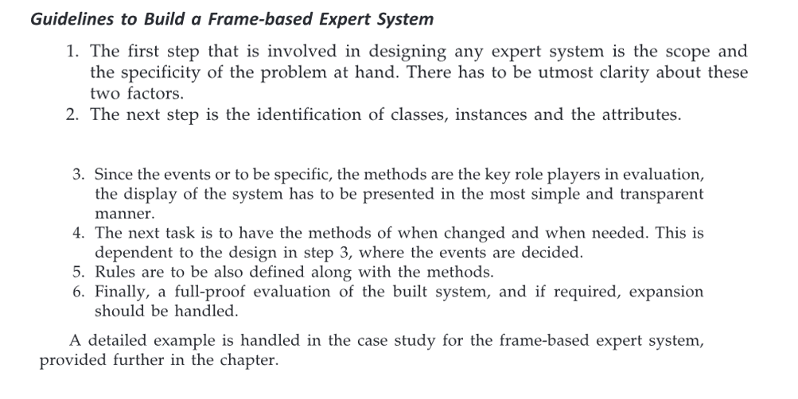
Guidelines to build a Frame-Based Expert System

Slide 42
MYCIN

Slide 43
MYCIN
•MYCIN was an early expert system that used artificial intelligence to identify bacteria causing severe infections.
•recommend antibiotics, with the dosage adjusted for patient's body weight
•The MYCIN system was also used for the diagnosis of blood clotting diseases.
•MYCIN was developed over five or six years in the early 1970s at Stanford University.
•It was written in Lisp

Slide 44
MYCIN
•MYCIN was a stand alone system that required a user to enter all relevant information about a patient by typing in responses to questions MYCIN posed.
•MYCIN operated using a fairly simple inference engine, and a knowledge base of ~600 rules.
•It would query the physician running the program via along series of simple yes/no or textual questions.

Slide 45
Tasks and Domain
•Disease DIAGNOSIS and Therapy SELECTION
•Advice for non-expert physicians with time considerations and incomplete evidence on:
–Bacterial infections of the blood
–Expanded to meningitis and other ailments
–Meet time constraints of the medical field

Slide 46
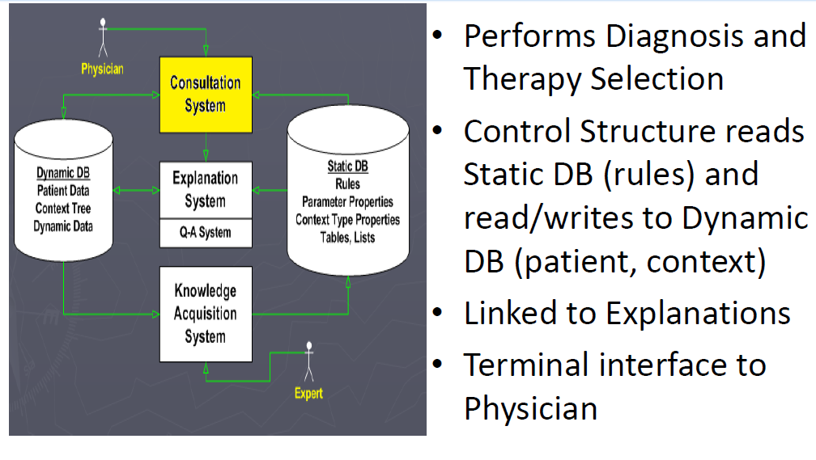
Consultation System

Slide 47
Consultation “Control Structure”
•Goal-directed Backward-chaining Depth-first Tree Search
•High-level Algorithm:
1.Determine if Patient has significant infection
2.Determine likely identity of significant organisms
3.Decide which drugs are potentially useful
4.Select best drug or coverage of drugs

Slide 48
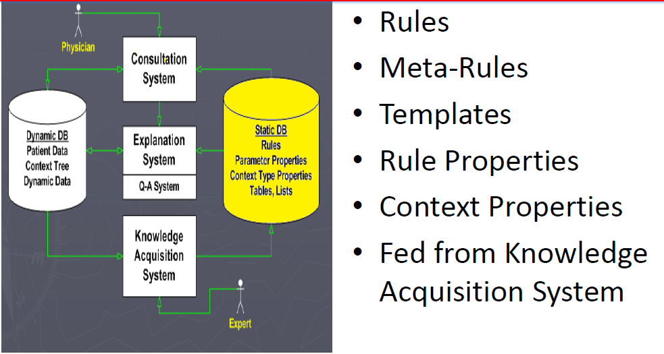
Static Database

Slide 49
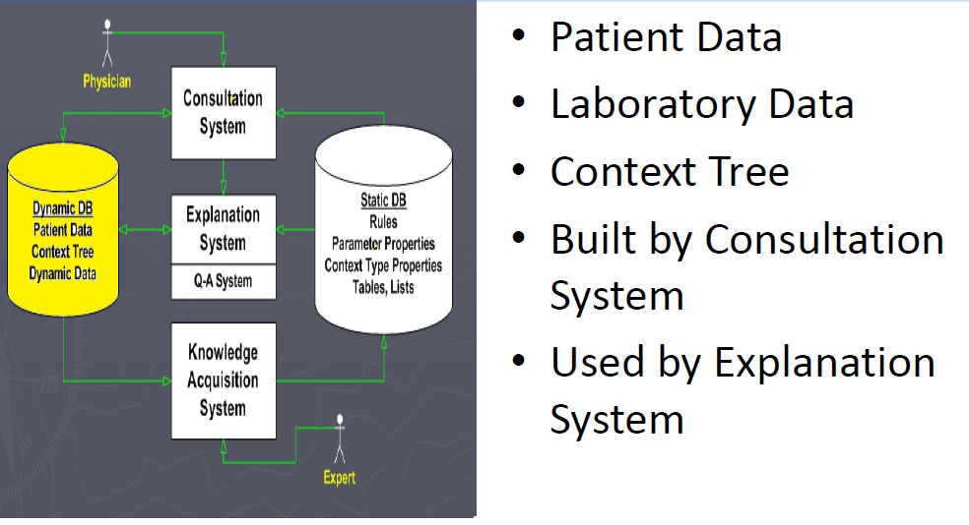
Dynamic Database

Slide 50
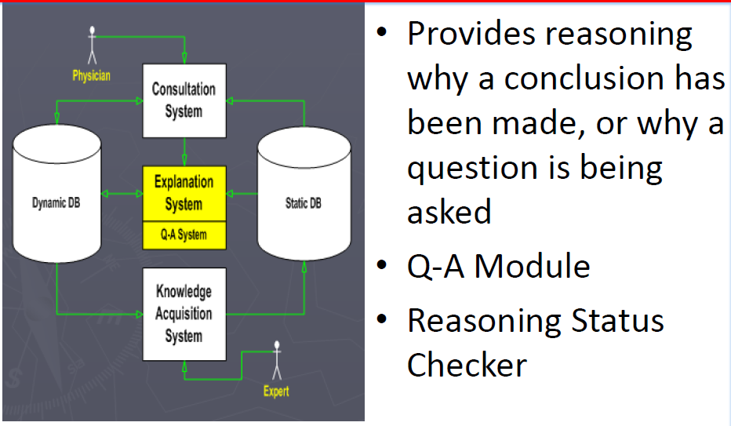
Explanation System

Slide 51
Xcon
•The R1 (internally called XCON, for eXpertCONfigurer) program was a production rule based system written in OPS5 by John P. McDermott of CMU in 1978.
–configuration of DEC VAX computer systems
•ordering of DEC's VAX computer systems by automatically selecting the computer system components based on the customer's requirements.
•XCON first went into use in 1980 in DEC's plant in Salem, New Hampshire. It eventually had about 2500 rules.
•By 1986, it had processed 80,000 orders, and achieved 9598% accuracy.
•It was estimated to be saving DEC $25M a year by reducing the need to give customers free components when technicians made errors, by speeding the assembly process, and by increasing customer satisfaction.
•XCON interacted with the sales person, asking critical questions before printing out a coherent and workable system specification/order slip.
•XCON's success led DEC to rewrite XCON as XSEL a version of XCON intended for use by DEC's salesforce to aid a customer in properly configuring their VAX.

Slide 52
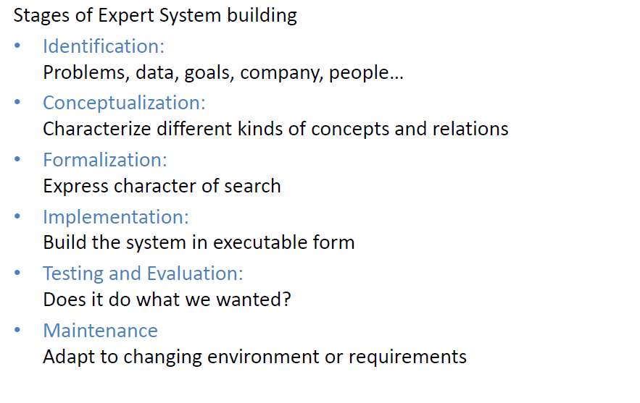
XCON: Expert Configurer

Slide 53
Natural Language Processing (NLP)

Slide 54
Natural language
• Natural languages are languages that living creatures use for communication,
• A machine is considered to be really intelligent only when it can understand and interpret or speak the matter of natural language.
• The capability to understand, interpret and communicate through natural language is a very important criteria of intelligent behavior.

Slide 55
Why Natural language processing?
• Huge amount of data?
– Internet=at least 2.5 billion pages
• Applications for processing large amounts of texts.
– Classify text into categories
– Index and search large texts
– Automatic translation
– Speech understanding: Understanding phone conversation
– Information extraction: Extract useful information from
resumes
– Automatic summarization
– Question answering
– Knowledge acquisition: knowledge from expert
– Text generations/dialogs
• All these requires natural language expertise.

Slide 56
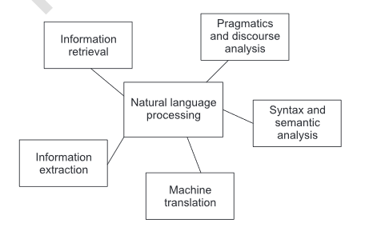
NLP Tasks

Slide 57
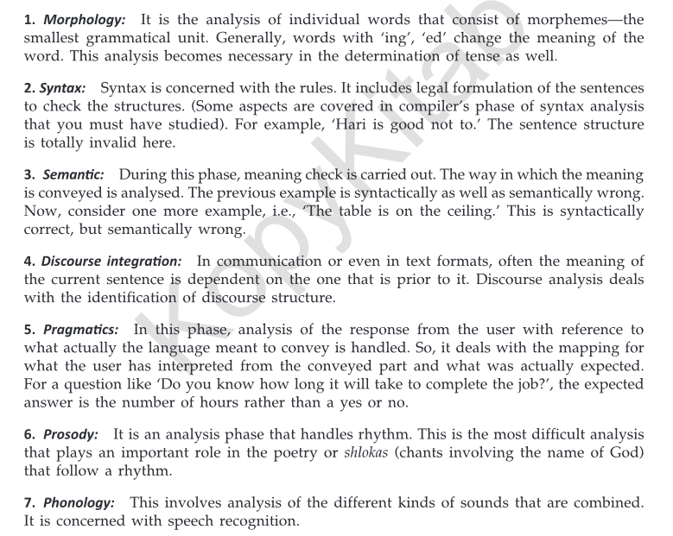
Levels of NLP

Slide 58
Syntactic Analysis
Rules of syntax (grammar) specify the possible organization of words in sentences and allows us to determine sentence’s structure(s)
“John saw Mary with a telescope”
John saw (Mary with a telescope)
John (saw Mary with a telescope)
Parsing: given a sentence and a grammar
Checks that the sentence is correct according with the grammar and if so returns a parse tree representing the structure of the sentence

Slide 59
Syntactic Analysis - Grammar
sentence -> noun_phrase, verb_phrase
noun_phrase -> proper_noun
noun_phrase -> determiner, noun
verb_phrase -> verb, noun_phrase
proper_noun -> [mary]
noun -> [apple]
verb -> [ate]
determiner -> [the]

Slide 60
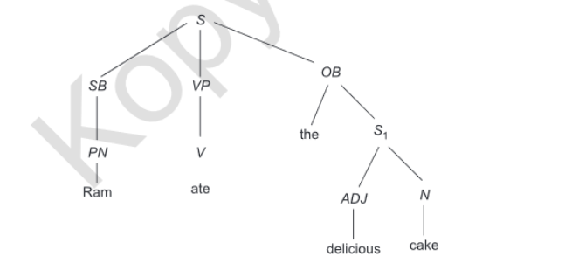
Syntactic Analysis - Parsing

Slide 61
Syntactic Analysis – Complications (1)
Number (singular vs. plural) and gender
sentence-> noun_phrase(n),verb_phrase(n)
proper_noun(s) -> [mary]
noun(p) -> [apples]
Adjective
noun_phrase-> determiner,adjectives,noun
adjectives-> adjective, adjectives
adjective->[ferocious]
Adverbs, …

Slide 62
Syntactic Analysis – Complications (2)
Handling ambiguity
Syntactic ambiguity: “fruit flies like a banana”
Having to parse syntactically incorrect sentences

Slide 63
Semantic Analysis
Syntax analysis is doing the parsing activity
But we need to understand the meaning of the words and it is done by semantic analysis
For example,
‘Keep the book on the table’ – Here table refers physical object
‘Learn the table of number 23’ – here table refers mathematics concept of table

Slide 64
Lexical Processing
In lexical processing, the meaning of the tokens is found out
Word sense disambiguation: Understanding the meaning of a particular word in the context
It is concerned with the sense where it would be operational
It would be done with the help of semantic marker
Semantic marker: ‘Keep’ in sentence 1
Semantic marker: ‘Learn’ in sentence 2

Slide 65
Semantic grammars
Example,
‘The pen is on the ceiling’
Solution is,
S -> Action the Food
Action -> eat|drink|shallow|chew – Set of words
Food -> burger|sandwich|coke|pizza – Set of words

Slide 66
Case Grammar
Case grammar is also called as Fillmore grammar
Elements of the sentence are:
Object (thing on which it is acted)
Agent/actor (Someone who carries out the action or the event)
Dative (Someone who is affected by the event)
Location (place where the event/action occurs)
Time (date or time at which the action/event takes place)
Example,
Rohit will meet Kunal at Mall

Slide 67
Conceptual Dependency
ATRANS: Transfer of some relationship for verb (e.g.) ’give’
PTRANS: Transfer of location of an object, say the verb ‘go’
GRASP: This primitive occurs with verb like ‘throw’
SPEAK: This primitive has some sound production, say the verb ‘speak’ or ‘say’

Slide 68
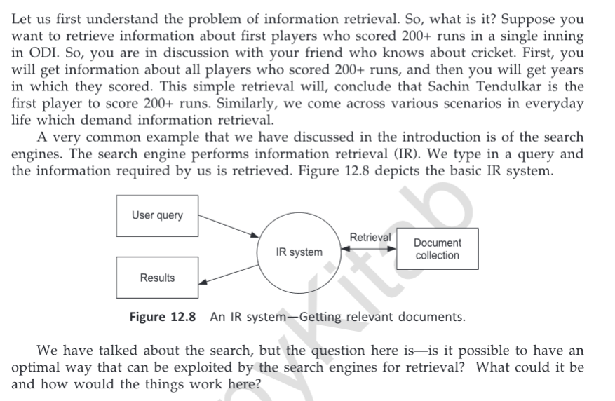
Information retrieval

Slide 69
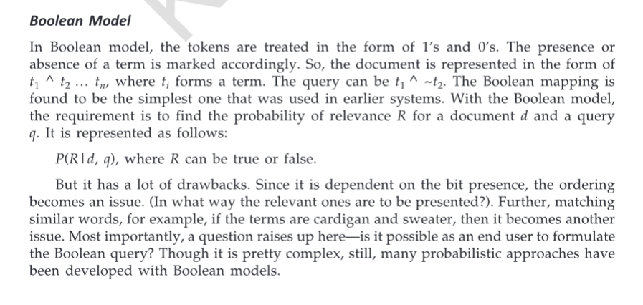
Information retrieval - Models

Slide 70
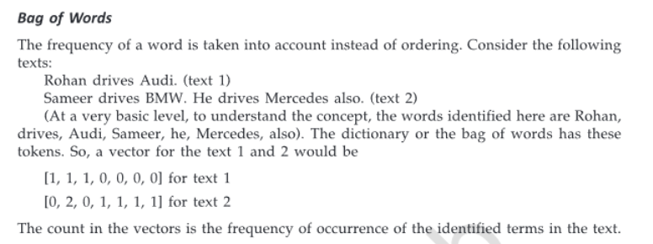
Information retrieval - Models

Slide 71
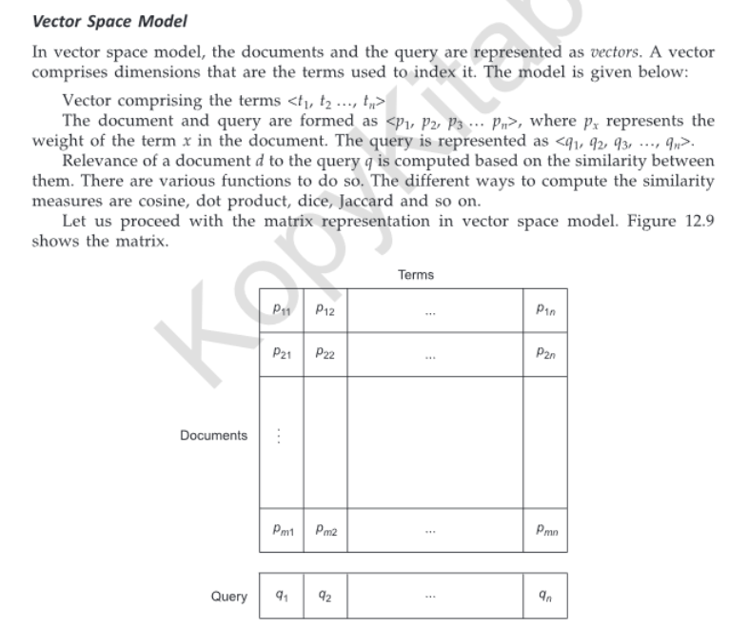
Information retrieval - Models

Slide 72
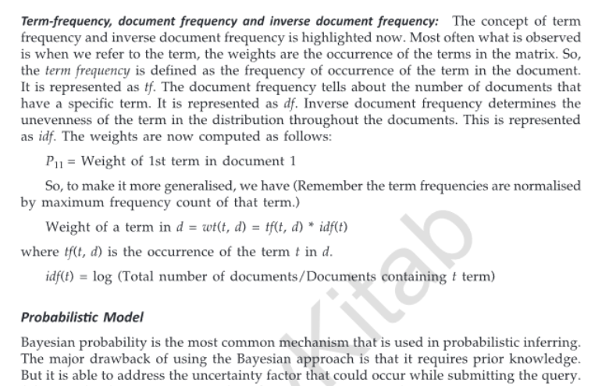
Information retrieval - Models

Slide 73
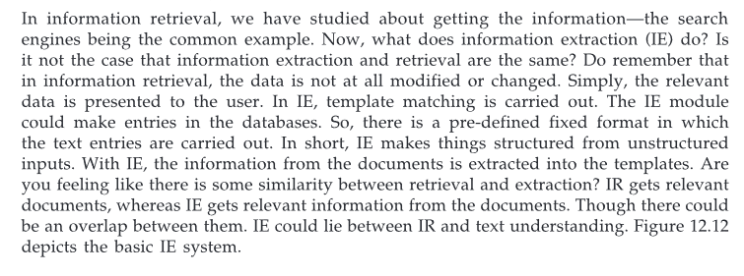
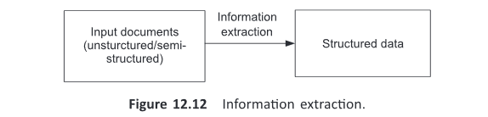
Information Extraction

Slide 74
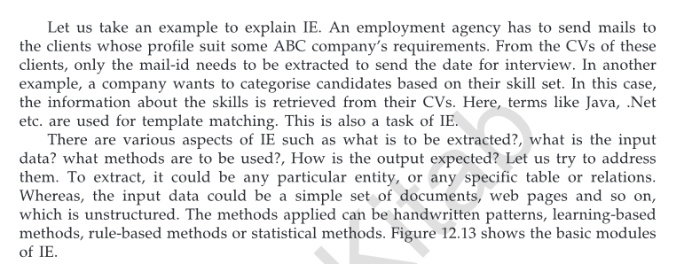
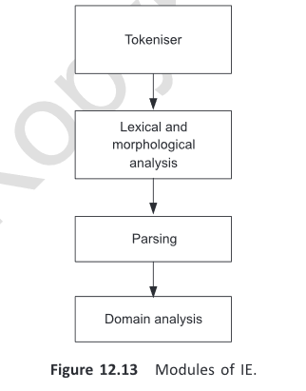
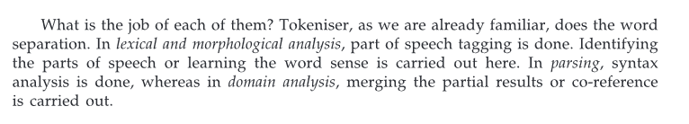
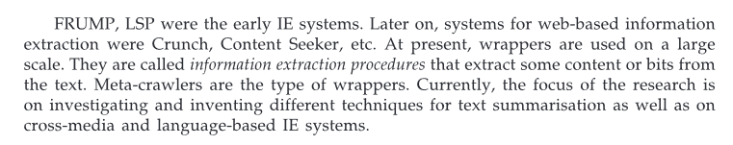
Information Extraction

Slide 75
Advance topics in Artificial Intelligence- Cloud Computing and Intelligent agent
Business Intelligence and Analytics
Sentiment Analysis
Deep Learning Algorithms
Planning and Logic in intelligent Agents

Slide 76
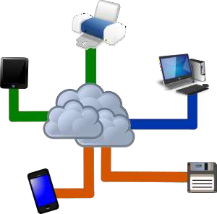
Advance topics in Artificial Intelligence- Cloud Computing and Intelligent agent
Cloud computing
The practice of using a network of remote servers hosted on the Internet
to:
store,
manage,
and process data,
rather than a local server or a personal computer.

Slide 77

Cloud computing and AI(contd.)
Cloud computing and AI
While artificial intelligence (A.I.) has struggled to gain footholds in other niches, it is finding its place in the world of cloud computing, a sort of revolution within the revolution that could rapidly change the face of businesses using cloud computing solutions over the next few years.

Slide 78
Cloud computing and AI(contd.)
In three areas of cloud computing, A.I. is taking long strides.
Those areas are
◆ Parallel processing
◆ Machine Learning-ML Algorithms
◆ Big Data

Slide 79
What’s parallel processing and how it work in cloud
Parallel processing means more than one microprocessor handling parts of the same overall task. Parallel processing essentially means that multiple processors shoulder the load. To have multiple processors working on the same problem at the same time, there are two big things you need:
Latency
Bandwidth

Slide 80
What’s parallel processing and how it work in cloud(contd.)
Latency
it refers to the amount of time it takes for a processor to send results back to the system. The longer the wait, the longer it will take the entire system to process the problem.
Bandwidth
Bandwidth is a more common term, referring to how much data a processor can send in a given length of time.

Slide 81
ML algorithms for cloud applications
Machine learning (ML) is a type of artificial intelligence (AI) that allows software applications to become more accurate in predicting outcomes without being explicitly programmed
For cloud applications Machine Learning algorithms are built

Slide 82
ML algorithms for cloud applications(contd.)
ML algorithms for cloud applications involve:
Cognitive computing(to combine different patterns together; i.e. voice, imagery or other such data; for mimicking human behavior)
Chatbots and virtual assistants (they are getting smarter every time they
have a conversation)
Internet of things-IoT (It connects every potentially “smart” machine in the world to the cloud and add that massive amount of data to the conversation)

Slide 83
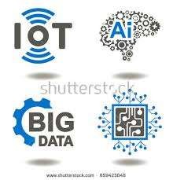
How AI uses big data
As business enterprises increasingly need a massive data- crunching champion, cloud computing companies have begun to deploy Artificial Intelligence as a service (AIaaS). Once AIaaS is deployed, it can begin crunching data at a faster rate than any single microprocessor or human mind could ever hope to compete with.

Slide 84
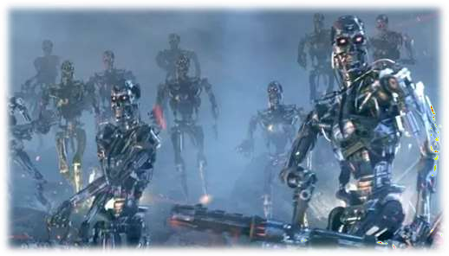
AI has not come to take over our world, but to improve the way we harness technology to make everything better. Consider the surface of AI finally scratched. ??

Slide 85
Business Intelligence and Analytics

Slide 86

So, how does AI actually work in the business world? let’s try to understand what artificial intelligence is and why it is so important for today’s business corporations.

Slide 87
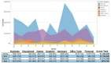
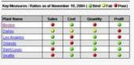
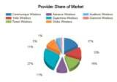
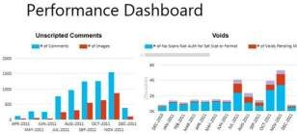
What is Business Intelligence (BI)?
Business intelligence systems are used to maintain, optimize and streamline current operations. BI improves and maintains operational efficiency and helps businesses increase organizational productivity. Business intelligence software confers many benefits, notably powerful reporting and data analysis capabilities. Using BI’s rich visualization mechanisms, managers are able to generate intuitive, readable reports that contain relevant, actionable data.
Popular business intelligence solutions include; SAP BusinessObjects, QlikView, IBM Cognos, Microstrategy, etc.
https://selecthub.com/business-intelligence/business-intelligence-vs-business-analytics/

Slide 88
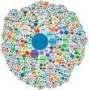
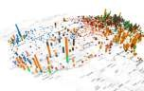
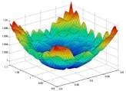
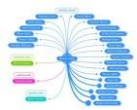
What is Business Analytics (BA)?
Like business intelligence, BA collects and analyzes data, employs predictive analytics and generates richly visualized reports, helping identify and address an organization’s weak points. That’s where similarities end. Business analytics software is used to explore and analyze historical and current data. It utilizes statistical analysis, data mining and quantitative analysis to identify past business trends.
Popular business analytics solutions include; SAP Business Analytics Suite, Pentaho BA, Birst BI and Tableau BIg Data Analytics.
https://selecthub.com/business-intelligence/business-intelligence-vs-business-analytics/

Slide 89


Business Analytics vs. Business Intelligence
What will happen?
What if and Why did it happen?
Predictive Modeling
Simulation/Optimization
Advanced Statistic Models
Data Mining (Text, Multimedia)
Data Science
Business Analytics
Vision, Mission Statements
“Sustainability” “Efficiency”
“Innovation”
Business Services & Business Objectives
New
Optimized Retired
Services Services
Services
Digital Organization
CEO
Who did that task?
What happened?
Dashboards, Alerts
Scorecards Monitoring
Slice & Dice, Drilling
Reports
CMO
COO
CFO
BI
Business Process as a Service
More Flexible More Control
Digital Initiatives
Business Process
Optimization/Outsourcing
New Customers, Channels
Enterprise Metamorphosis
Data Monetization
IoT, Smart Devices
Smart Workforce
Digital Platform
Cloud
DWH
Data Lake
Big Data
Digital Security
Danairat, 2016

Slide 90
Choosing between Business Intelligence (BI) and Business Analytics (BA)
While superficially similar, the difference between business intelligence vs business analytics is clear:
BI uses past and current data to optimize the present for current success.
BA uses the past and analyzes the present to prepare businesses for the future.
Choosing the solution for your business depends on your aims.
If you are satisfied with your business model as a whole and mainly wish to improve operations, increase efficiency and meet organizational goals, business intelligence may be an optimal solution.
If you intend to change your business model and need to know where to start, business analytics might be the best option.
https://selecthub.com/business-intelligence/business-intelligence-vs-business-analytics/

Slide 91
Choosing between Business Intelligence (BI) and Business Analytics (BA)
Business Intelligence (BI)
BI has the added advantages of targeting a business’s weak areas and providing actionable solutions to those problems. Business Intelligence software is an excellent solution for managers who want to improve decision making and understand their organization’s productivity, work processes and employees. And, with that understanding, improve their business from the ground up.
Business Analytics (BA)
If your organization is a new entity, or in the midst of significant changes, business analytics software is a serious contender. BA uses historical data, current information, and projected trends to ensure your business makes the right changes. Business analytics is the solution if you want to analyze your company, your market, and your industry with the dual goals of optimizing current performance and predicting business trends to help you remain competitive in the future.
Most businesses want a combination of current success and future preparation. Alone or together, business analytics and business intelligence can help you take your business where you want it to go.
https://selecthub.com/business-intelligence/business-intelligence-vs-business-analytics/

Slide 92

1. (Re)Identifying your vision and missions
Strategic and Top Decision Making:-
- Political and Policy Reports
Economic Reports
Customer Analytic Trends
Technology Trends
Economic Value
Vision, Mission Statements
“Sustainability” “Efficiency”
“Innovation”
Business Services & Business Objectives
New
Optimized Retired
Services Services
Services
Digital Platform
Cloud
Big Data
Digital Security

Slide 93
2. Identifying Business Services and Objectives
Business Services/Objectives:-
- Social Listening Analytics
Vision, Mission Statements
“Sustainability” “Efficiency”
“Innovation”
Customer Experiences / UX
Discover Unman Customers
Demographic Analytics
Voice of Customers
Objectives/Measurements Results
Business Services & Business Objectives
New
Optimized Retired
Services Services
Services
Digital Platform
Cloud
Big Data
Digital Security

Slide 94

3. Identifying BI for Management Level
Vision, Mission Statements
“Sustainability” “Efficiency”
“Innovation”
Management BI:-
Promotion Impact Report
Channel Productivity
Operational Efficiency
Profit and Loss Report
Compliance Reports
Internal Policy Adoption
Business Services & Business Objectives
New
Optimized Retired
Services Services
Services
Digital Organization
CEO
CMO
COO
CFO
Digital Platform
Cloud
Big Data
Digital Security

Slide 95
Digital Organization
CEO
CMO
COO
CFO
CEO : combine all successes from all C-Level
CMO: innovation for new products offering
COO : operation and automation
CFO : finance, budgeting, HR, Audit, QA and IT
Put the right skill on the right role
Promote paperless policy organization

Slide 96
Top Business Questions from CMO
CMO
Chief Marketing Officer (CMO), Innovation, Sales and Promotion:-
Which customers should we target?
What has caused the change in my pipeline?
Which are my most profitable campaigns/region?
Did store sales spike when we advertised in the local paper or launched the campaign?
What is the most profitable sales channel and how has that changed over time?

Slide 97
Top Business Questions from COO
COO
Chief Operation Officer (COO):-
Lead time and cost of production for each products
Which order processing processes are most inefficient?
Which vendors are best at delivering on time and on budget?–
How many additional personnel do we need to add per branch?
Percent of error or defect trend for each product

Slide 98
Top Business Questions from CFO
CFO
Chief Financial Officer (CFO):-
What is the fully loaded cost of new products deployment?
What are the current trends in cash flow, accounts payable and accounts receivable and how do they compare with plan?
What is the expected annual profit/loss based on current marketing and sales forecasts?
How are forecasts trending against the annual plan?

Slide 99
4. Identifying Operational BI
Vision, Mission Statements
“Sustainability” “Efficiency”
“Innovation”
Operational BI:-
- Task Tracking Status
Business Services & Business Objectives
Alerts on Progression
Error correction and recommendation
New
Optimized Retired
Services Services
Services
Digital Organization
CEO
CMO
COO
CFO
Business Process as a Service
More Flexible More Control
Digital Initiatives
Business Process
Optimization/Outsourcing
New Customers, Channels
Enterprise Metamorphosis
Data Monetization
IoT, Smart Devices
Smart Workforce
Digital Platform
Cloud
Big Data
Digital Security

Slide 100
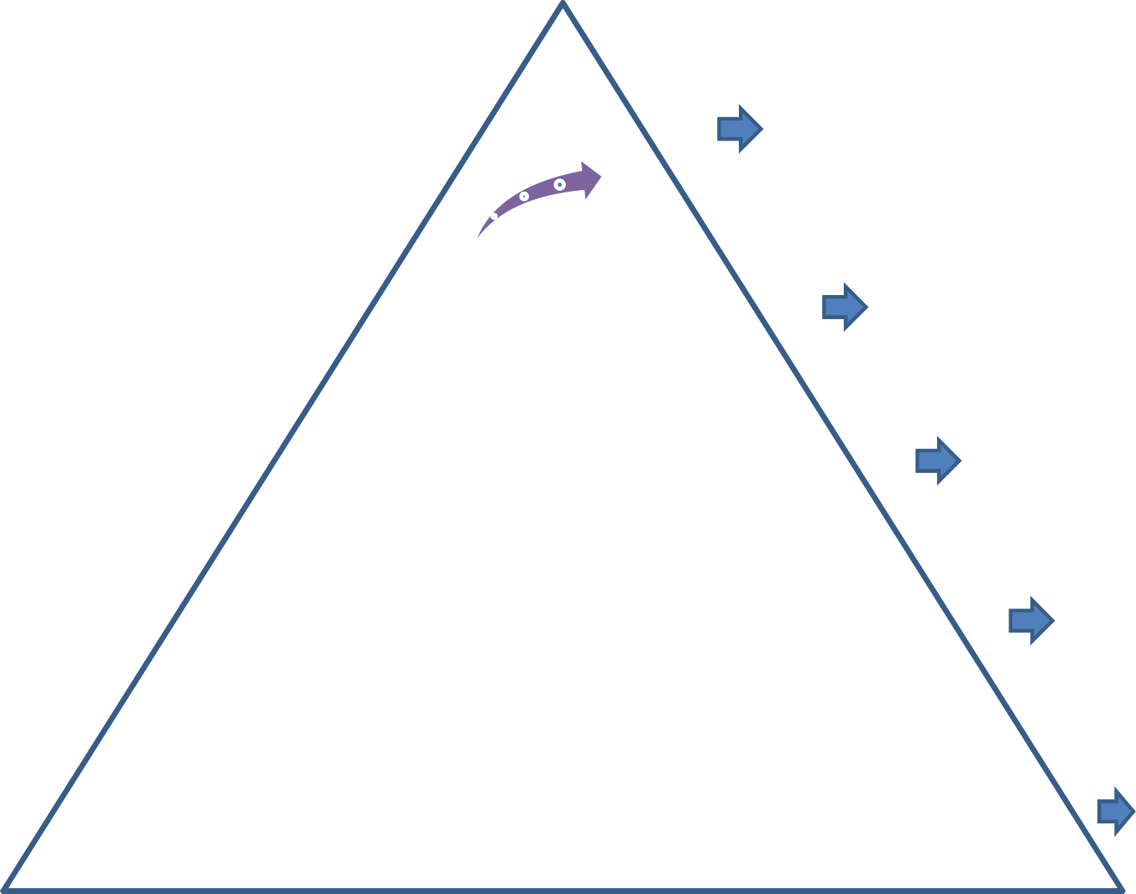
Key Questions Type in each level of enterprise
Vision, Mission Statements
“Sustainability” “Efficiency”
“Innovation”
Why
Business Services & Business Objectives
When
New
Optimized Retired
Services Services
Services
Digital Organization
CEO
Who
CMO
COO
CFO
Business Process as a Service
More Flexible More Control
How
Digital Initiatives
Business Process
Optimization/Outsourcing
New Customers, Channels
Enterprise Metamorphosis
Data Monetization
IoT, Smart Devices
Smart Workforce
Digital Platform
Cloud
What
Big Data
Digital Security
Danairat, 2016

Slide 101
5. Identifying BI and BA Platform
Vision, Mission Statements
“Sustainability” “Efficiency”
“Innovation”
Business Services & Business Objectives
New
Optimized Retired
Services Services
BI & Business Analytics Platforms :-
Traditional BI
Big Data
Cloud
Digital Security
Services
Digital Organization
CEO
CMO
COO
CFO
Business Process as a Service
More Flexible More Control
Digital Initiatives
Business Process
Optimization/Outsourcing
New Customers, Channels
Enterprise Metamorphosis
Data Monetization
IoT, Smart Devices
Smart Workforce
Digital Platform
Cloud
Big Data
Digital Security

Slide 102
Summary
What will happen?
What if and Why did it happen?
Predictive Modeling
Simulation/Optimization
Advanced Statistic Models
Data Mining (Text, Multimedia)
Data Science
Business Analytics
Vision, Mission Statements
“Sustainability” “Efficiency”
“Innovation”
Business Services & Business Objectives
New
Optimized Retired
Services Services
Services
Digital Organization
CEO
Who did that task?
What happened?
Dashboards, Alerts
Scorecards Monitoring
Slice & Dice, Drilling
Reports
CMO
COO
CFO
BI
Business Process as a Service
More Flexible More Control
Digital Initiatives
Business Process
Optimization/Outsourcing
New Customers, Channels
Enterprise Metamorphosis
Data Monetization
IoT, Smart Devices
Smart Workforce
Digital Platform
Cloud
DWH
Data Lake
Big Data
Digital Security
Danairat, 2016

Slide 103






Big Data for Business Analytics Platform
Customers
Staffs
Managers Partners
Experts
Executives
Big Data Applications
Fraud
Next Best Action
BI/Report
Cyber
Talent Search
Analysis Security
Big Data Platform
Descriptive/
Diagnose Analytics
Predictive Analytics
Prescriptive Analytics
Monitoring, Resource Management and Metadata Framework
Parallel Data Processing, Refinery
Security and Control Framework
Distributed Data Store, Data Lake
Ingestion and Acquisition
Big Data Infrastructure
Compute Storage, Network
Big Data Infrastructure

Slide 104

Internet of Things and Real-time Data Feeds
Application Areas
Smart Cities
Smart Environment
Smart Energy
Smart Agriculture
E-Health
Retail
Logistics
Industrial Control
37
Monika, 2015

Slide 105

Smart Home
38
Monika, 2015

Slide 106





Based on these capabilities, we have seen multiple applications of artificial intelligence in business in the form of:
Chatbots, virtual assistants, and business intelligence bots
Targeted online advertising
Predictive analytics
Voice recognition
Pattern recognition

Slide 107
Sentiment Analysis

Slide 108
Sentiment Sentiment Analysis
A thought, view, or attitude, especially one based mainly on emotion instead of reasonSentiment Analysisaka opinion mininguse of natural language processing (NLP) and computational techniques to automate the extraction or classification of sentiment from typically unstructured text

Slide 109


Slide 110


Slide 111


Slide 112
Sentiment analysis has many other names
Opinion extraction
Opinion mining
Sentiment mining
Subjectivity analysis

Slide 113

What is SA & OM?
Identify the orientation of opinion in a piece of text
Can be generalized to a wider set of emotions
The movie
was fabulous!
The movie
stars Mr. X
The movie
was horrible!

Slide 114


Positive or negative movie review?
unbelievably disappointing
Full of zany characters and richly applied satire, and some great plot twists
this is the greatest screwball comedy ever ﬁlmed
It was pathetic. The worst part about it was the boxing scenes.

Slide 115
Why sentiment analysis?
Movie: is this review positive or negative?
Products: what do people think about the new iPhone?
Public sentiment: how is consumer conﬁdence? Is despair increasing?
Politics: what do people think about this candidate or issue?
Prediction: predict election outcomes or market trends from sentiment

Slide 116
Why compute aﬀective meaning?
Detecting:
sentiment towards politicians, products, countries, ideas
frustration of callers to a help line
stress in drivers or pilots
depression and other medical conditions
confusion in students talking to e-­‐tutors
emotions in novels (e.g., for studying groups that are feared over time)
Could we generate:
emotions or moods for literacy tutors in the children’s storybook domain
emotions or moods for computer games
personalities for dialogue systems to match the user

Slide 117
Scherer’s typology of aﬀective states
Emotion: relatively brief episode of synchronized response of all or most organismic subsystems in response to the evaluation of an event as being of major signiﬁcance
angry, sad, joyful, fearful, ashamed, proud, desperate
Mood: diﬀuse aﬀect state …change in subjective feeling, of low intensity but relatively long duration, ojen without apparent cause
cheerful, gloomy, irritable, listless, depressed, buoyant
Interpersonal stance: aﬀective stance taken toward another person in a speciﬁc interaction, coloring the interpersonal exchange
distant, cold, warm, supportive, contemptuous
A]tudes: relatively enduring, aﬀectively colored beliefs, preferences predispositions towards objects or persons
liking, loving, hating, valuing, desiring
Personality traits: emotionally laden, stable personality dispositions and behavior tendencies, typical for a person
nervous, anxious, reckless, morose, hostile, envious, jealous

Slide 118

Google Product Search
a

Slide 119

TwiGer sentiment:
Johan Bollen, Huina Mao, Xiaojun Zeng. 2011.
Twitter mood predicts the stock market,
Journal of Computational Science 2:1, 1-­‐8. 10.1016/j.jocs.2010.12.007.

Slide 120

Bollen et al. (2011)
CALM predicts DJIA 3 days later
At least one current hedge fund uses this algorithm
Dow Jones
CALM

Slide 121


Slide 122


Slide 123


Slide 124
DEEP LEARNING

Slide 125


Slide 126














Slide 127







MACHINE LEARNING
Train machine by ourselves
Extract feature and feed to the machine then apply algorithm to train it

Slide 128








ML VS DL

Slide 129



DEEP LEARNING
It’s a type of ML inspired by human brain.
In DL, the structure is called
artificial neural network.
In DL, machine learns itself using artificial neural network that mimics biological neural network.

Slide 130





Slide 131













CONVOLUTIONAL NEURAL NETWORK

Slide 132

















CONVOLUTIONAL NEURAL NETWORK (CNN)
Image recognition
Image classification
Object detection

Slide 133






CNN LAYER

Slide 134


CONVOLUTION LAYER
An image matrix (volume) of dimension (h x w x d)
A filter (fh x fw x fd)
Out put a volume dimension

Slide 135





Image Matrix
Filter Matrix
Convolved Feature

Slide 136






STRIDE

Slide 137

PADDING
Pad the picture with zero-padding so that it fits.
Drop part where image did not if. This called valid padding which keep only valid part of image.

Slide 138













SEPARABLE CONVOLUTION LAYER
The spatial separable convolution is so named because it deals primarily with the spatial dimensions of an image and kernel: the width and the height. (The other dimension, the “depth” dimension, is the number of channels of each image).
I also use this layer in my project too

